Slide 1
Automatic Hand-in-Eye Calibration using EKF 16-833: Robot Localization & Mapping
- Aditya Ramakrishnan - Chinmay Garg - Haoyang He - Sandeep Keshavegowda - Shravan Kumar Gulvadi

Slide 2
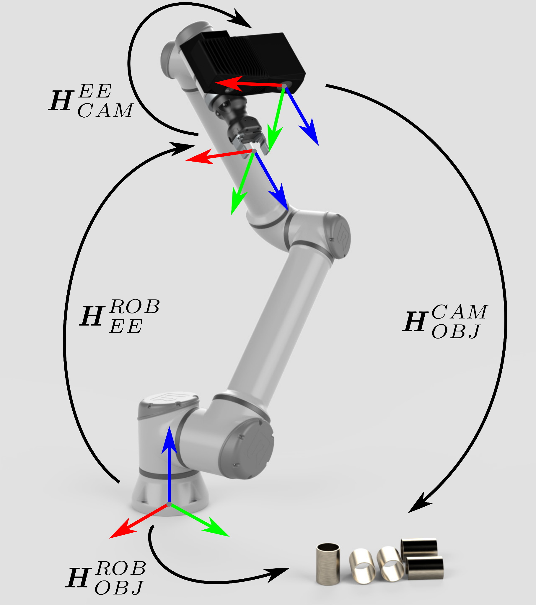
Introduction
Goal: Automatically calibrate the positioning of a robot-mounted camera using a SLAM-based approach (EKF).
Eye-in-Hand calibration: process of determining relative pose of a robot-mounted camera with respect to the robot’s end-effector.
Usually done by capturing a set of images of a static object of known geometry with the robot arm located in a set of different positions and orientations.
© Copyright 2015-2022 (C) Zivid AS
Notes:
Why this problem? Eye in Hand
For larger FOV’s, the robot can reorient for imaging from afar (helps even with robot interfering occlusions).
Imaging an object from multiple viewpoints allows a more complete 3D model (can also mitigate problems with specular reflections).
Disadvantages?
Payload reduced due to existing camera weight.
Image capture only when stationary.

Slide 3
Methodology

Slide 4
Methodology
Landmark Measurement : - QR Key-point detection & Depth estimation
Camera Projection Model : - Image coordinates to Camera coordinates
EKF-based Camera Localization
Calibration :
- World to Camera Transformation Matrix
Notes:
To perform the calibration involves a robot making a series of planned movements - At the end of each movement, the camera takes an image of the calibration object - The calibration object pose is extracted from the image, and the robot pose is registered from the controller. - To achieve good calibration quality, the robot poses used when the camera takes images of the calibration object should be: - sufficiently distinct - using all the robot joint results in a diversity of perspectives with different viewing angles
At the same time, the calibration object should be fully visible in the field of view of the camera task is then to solve homogeneous transformation equations to estimate the rotational and translational components of the locations of the calibration object and those of the hand-eye transformation.

Slide 5
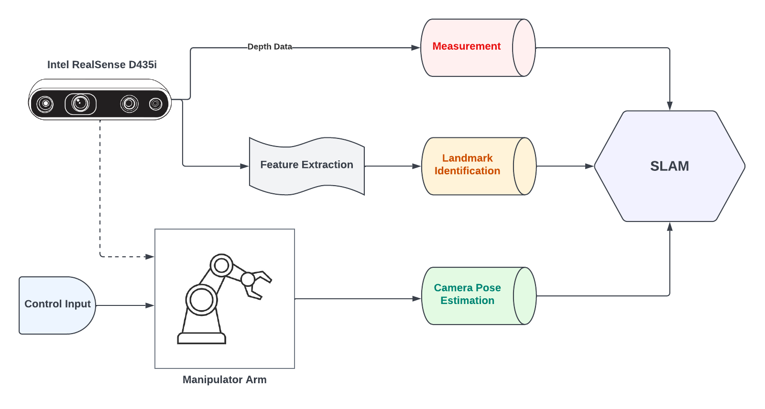
System Overview
Notes:
Move the robot to a new posture
Register the end-effector pose
Image the calibration object (obtain its pose)
Repeat steps 1-3 multiple times, e.g. 10 - 20
Compute hand-eye transform

Slide 6
Experimental Setup & Results

Slide 7
System Description
Sensor : Intel Realsense D435i camera with RGB and Depth data extraction
Robot Manipulator : Universal Robots - UR5 Arm (6DoF)
Landmark : Set of 8 static Quick-Response (QR) Markers
Assumptions: - Fully calibrated UR5 manipulator - Camera to End-effector transform “X” remains same throughout - Camera position fixed and observes all landmarks at each measurement

Slide 8
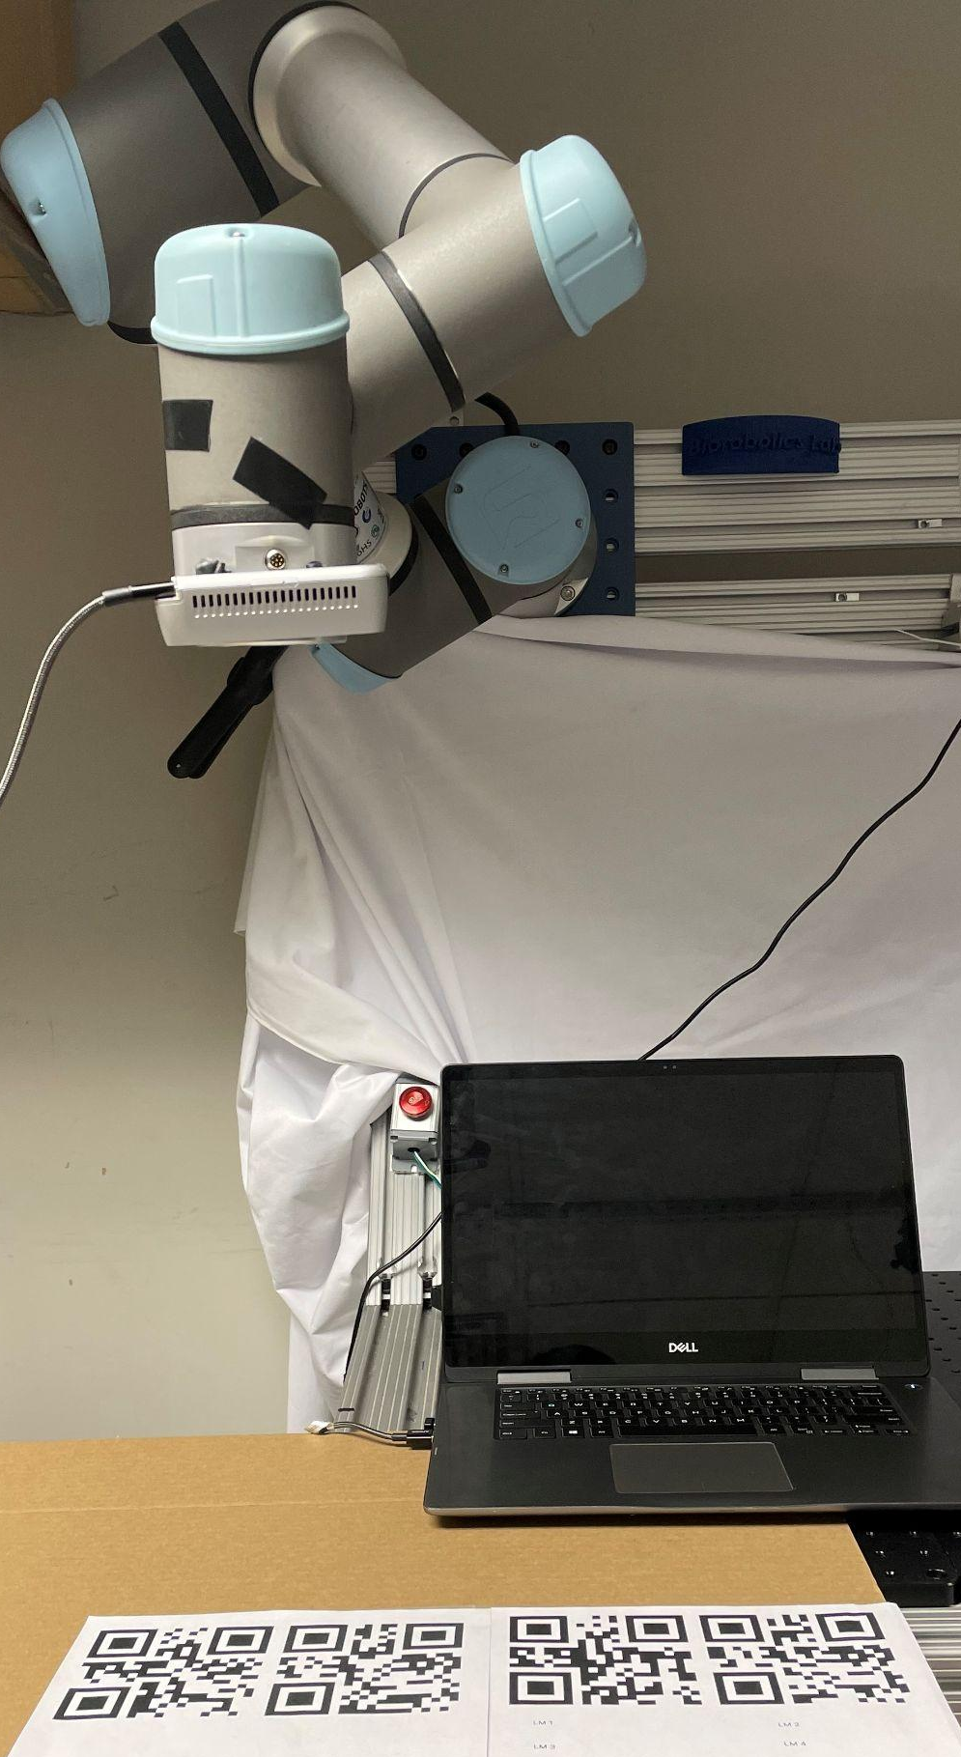
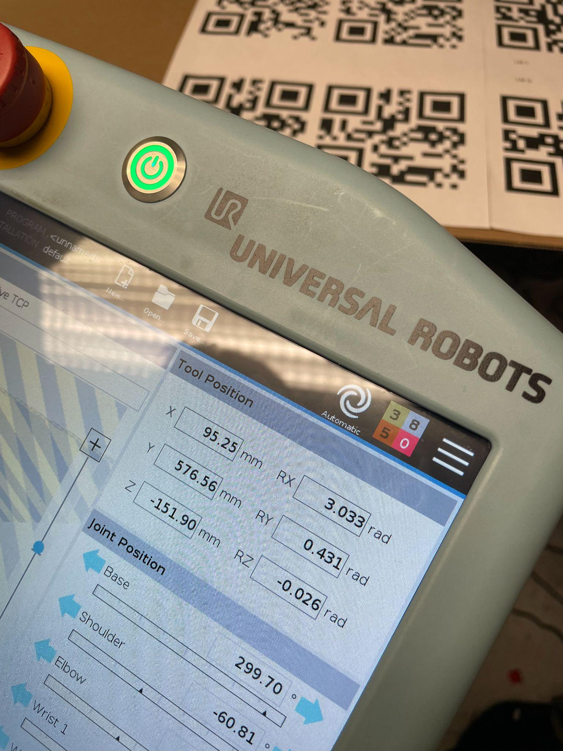
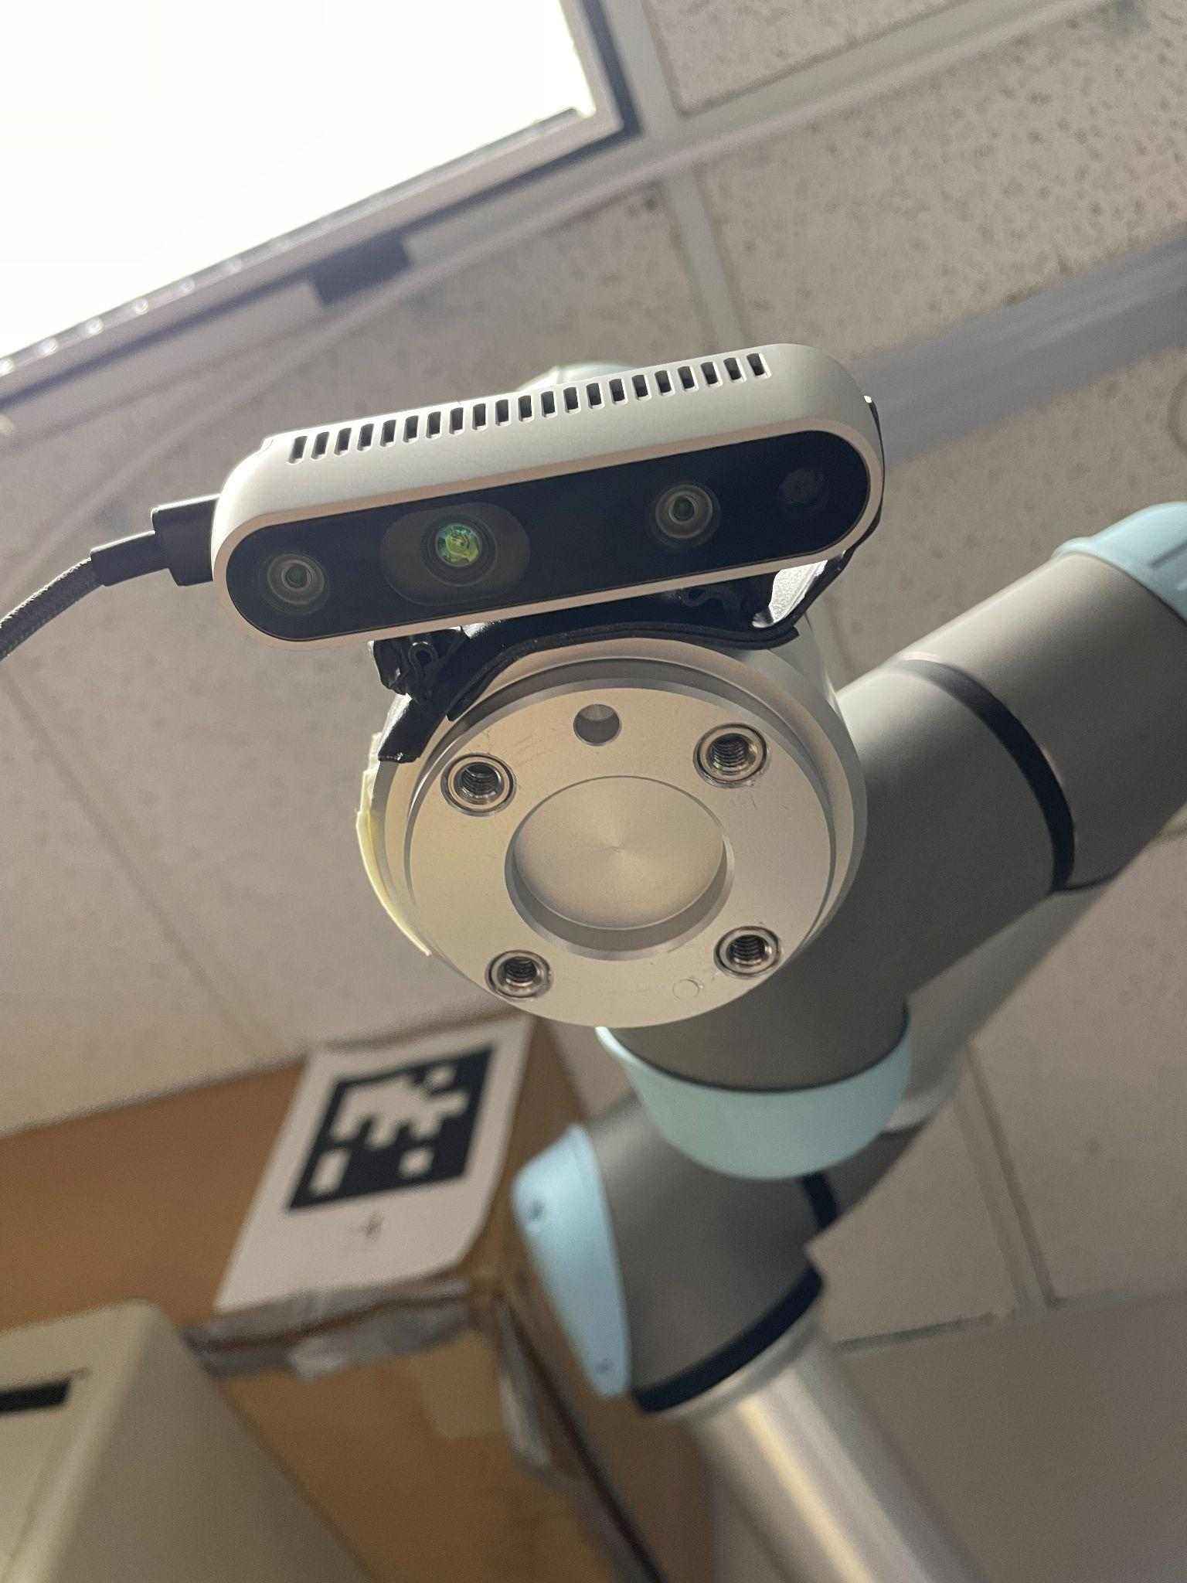
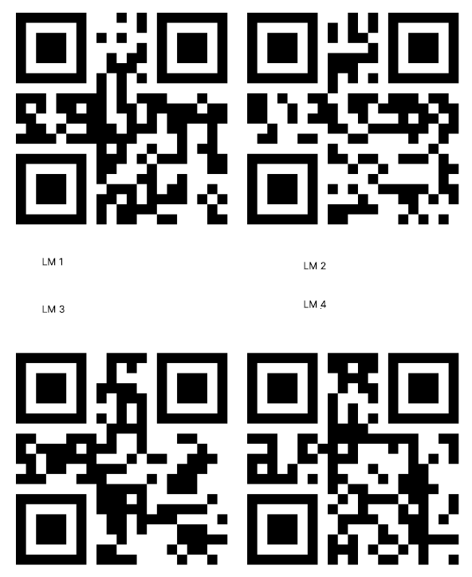
D435i Intel Realsense Depth Camera & QR Markers
Teach-Pendant with End-Effector Pose
Test Setup for camera-mounted UR5 Manipulator

Slide 9
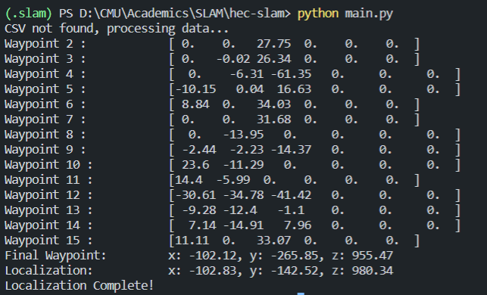
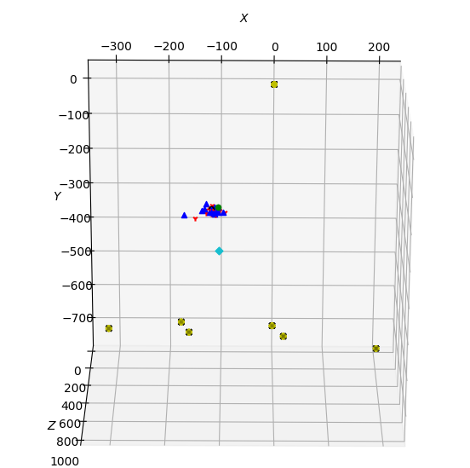
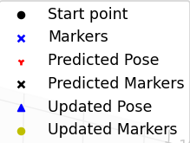
Results: Localization

Slide 10
Results: Analysis
Relatively accurate localization on x-axis and z-axis.
Less accurate on y-axis (perpendicular to camera):
Error from realsense in far-range measurements
Once we obtained the results after localization we calculated the robot end-effector to camera transformation by converting the localized state variable into a homogeneous transformation matrix.

Slide 11
Takeaways

Slide 12

Inferences
Positive
Negative
SLAM based approaches are well suited to solve online robotic arm calibration problem
EKF is appropriate for applications that require a significant amount of time to collect and process data measurements.
In general, for highly nonlinear functions, where we estimate the pose, EKF can significantly underestimate the covariance.
Alternative approaches to the localization problem:
Iterated EKF (IEKF)
Unscented KF
Factor Graph-based Optimization

Slide 13
Roadblocks & Future Work

Slide 14

Roadblocks & Challenges
Simulation: Issues with system dependencies, knowledge of URDF and Gazebo world setup proved to be a challenge.
All 6 DOF of camera: Our system is currently restricted to planar motion in 3D space - orientation changes are currently an implementation we are trying to achieve.
Sum of Gaussian: Unable to implement the sum of gaussians approach
Notes:
Firstly, very few calibration methods based on SLAM, and barely any with open-sourced, well-documented codebase.
Temperature, joint friction, payload, and manufacturing tolerances are some of the factors that cause the robot to deviate from its preprogrammed positioning.
If the robot loses the calibration, the picking accuracy will deteriorate. Repeating the calibration (robot and/or hand-eye) can compensate for such deteriorated performance.

Slide 15
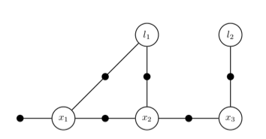
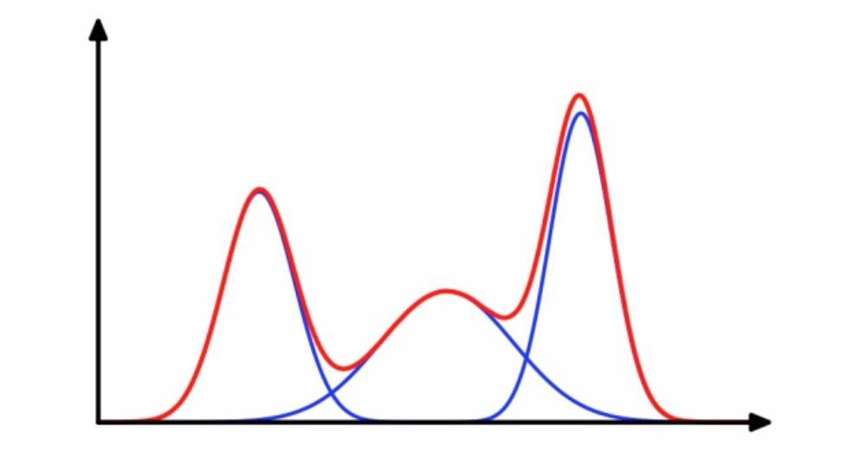
Future Work
Visual landmarks using key-point feature (SIFT, ORB, etc.) from environment
Factor Graph-based Least Squares approach for batch
Sum of Gaussians (SoG) for uncertainty
Fully-automatic Calibration (no manual intervention)
Notes:
a
Although, there are no drawbacks specifically with EKF for this application, factor graph based methods might be better suited for this application.
SoG (multiple EKFs) or and IEKF would help deal with uncertainty associated with end-effector pose, changes in the QR board, etc better.

Slide 16
Thank You

